Slide 1
NEURO
NURTURE
[Group]
[Date]

Slide 2
How can we improve the lives of Kansans —and the Kansas economy— from the very start?

Slide 3
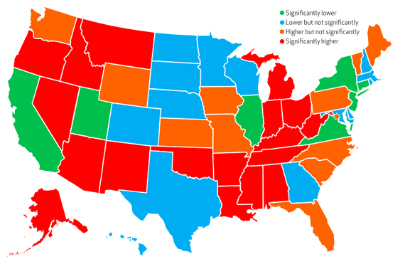
Nearly a quarter of all children experience two or more stressful childhood events,
setting them up for worse physical and mental health later in life
Kansas ranks on
the high side
Significantly lower
Lower but not significantly
Higher but not significantly
Significantly higher
Source: 2011-12 National Survey of Children's Health https://www.theatlantic.com/health/archive/2014/12/half-of-all-kids-experience-traumatic-events/383630/?utm_source=atlfb

Slide 4
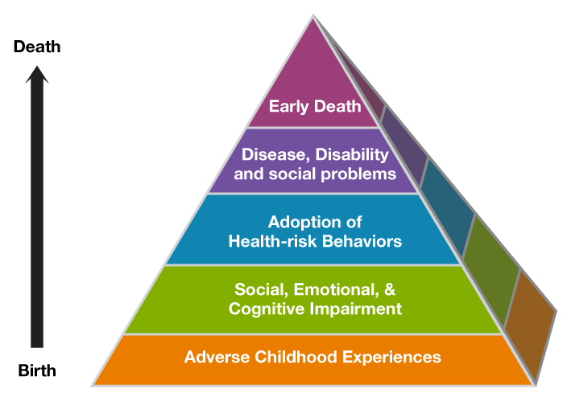
Adverse childhood experiences (ACES) lay the foundation for troubled lives

Slide 5
ACES have long-term economic impact
-$$$
Fewer taxpayers
Increased prison load
Less educated, less reliable workforce
Greater Medicaid costs
Increased special education load
Increased foster care load

Slide 6
What can we do about this?

Slide 7
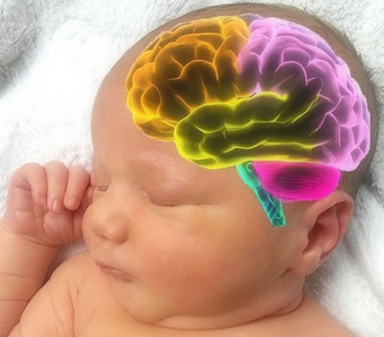
Brain science gives us new information
Adverse Childhood Experiences
Divorce/Separation
Loss of parent
Parent in jail or prison
Living with depressed or mentally ill parent
Parental substance abuse
Witness violence at home
Victim of violence or abuse at home
Economic hardship (food/housing)
Neglect
Lifespan Impacts
Chronic disease
Psychiatric disorders
Impaired cognition
Work/school attendance, behavior, and performance problems
Obesity
Substance abuse
Risky sex
Crime
Poverty
Intergenerational transmission, disparity
Brain Development
Electrical, chemical, cellular mass
Brain Adaptation
Hard-wired into biology
Source: Family Policy Council, 2012

Slide 8
ACES CAUSE CORTISOL OVERLOAD
Babies’ brains are on fire in Kansas, overloaded with the toxic levels of the stress hormone cortisol

Slide 10
NEURONURTURE
A new, science-based intervention called
Attachment Biobehavioral
Catch-up (ABC)
can help regulate cortisol in just 10 weeks

Slide 12
What is ABC?
ABC helps caregivers re-interpret children's behavioral signals so that they provide nurturance even when it is not elicited.
ABC helps caregivers provide a responsive, predictable environment that enhances young children's behavioral and regulatory capabilities.

Slide 13
ABC – How it’s implemented
One-hour home visits implemented over 10 weeks, using existing home visiting resources
Targeted at caregivers and children between ages 6 months and 24 months
Implemented by “Parent Coaches” trained by the developers from University of Delaware
Each session is video recorded for evaluation

Slide 14
ABC – Cortisol testing component
Random cheek/saliva swab at the beginning and end of implementation
Collected twice a day by parents
Evaluated by researchers at University of Kansas

Slide 15
ABC Benefits
Quick - 10 week program
High return on investment
Evidence-Based
HHS approved
Rated 1 on the California Evidence-Based Clearinghouse for Child Welfare scientific rating scale (strongest research evidence among those rated)
Proven to regulate cortisol levels in infants and toddlers

Slide 16
ABC Initiative Grant Investing $2,400,000 in 5 test sites (35 counties)
Northwest Kansas Council on Substance Abuse Cheyenne, Rawlins, Decatur, Norton, Sherman, Thomas, Sheridan, Graham, Wallace, Logan, Gove, and Trego
Project Eagle—KU
Wyandotte County
Rainbows United Sedgwick and (some of) Butler Counties
Russell Child Development Center Greeley, Wichita, Scott, Lane, Ness, Hamilton, Kearny, Finney, Hodgeman, Stanton, Grant, Haskell, Gray, Ford, Morton, Stevens, Seward, Meade, and Clark.
Horizons Mental Health Center Reno County

Slide 17
What we’re doing here in [location]
[Insert your own information. Use multiple slides if needed.]
Funding partners here
How’re we’re integrating ABC into our existing EC programs
Meet our parent coach(es)
Success story (video?)

Slide 18
RETURN ON INFANTS (ROI)
Science-based, short-term early intervention can help ensure bright futures for Kansas children and the state’s economy

Slide 19
+ Decrease foster care load + Decrease special education load + Decrease Medicaid costs
Early childhood programs save 13% PER YEAR over a child’s life
+ Decrease prison load + More educated, productive workforce + More taxpayers
Source: https://heckmanequation.org/resource/invest-in-early-childhood-development-reduce-deficits-strengthen-the-economy/

Slide 21
What legislators can do
Protect the Children’s Initiatives Fund
Advocate for ABC program to be incorporated into foster care and other existing early childhood programs as an “episode of care”
Get involved in local early childhood boards and initiatives
Encourage both public and private local investment in science-based early childhood programs

Slide 22
What foundations can do
Start community conversations around the value of early childhood programs
Invest in evidence-based early childhood programs
Invest in sustaining—and expanding—the ABC pilot project
Establish an early childhood fund

Slide 23
What the business community can do
Get involved in local early childhood boards and initiatives
Encourage both public and private investment in science-based early childhood programs
Donate individually to your local community foundation’s early childhood fund. (Establish one if one does not yet exist.)

Slide 24
What early childhood organizations can do
Refer families into the program
Transition to use of evidence-based programs—especially short episodes within existing programs
Educate policymakers and business leaders on the value of evidence-based early childhood programs
Recruit community and business leaders to serve on your boards

Slide 25
Questions?

